Slide 1

Stock market prediction
Using machine learning

Slide 2
Group members
Panwar Shivani (190180101038)
Priya Joshi (190180101042)
Shivani Sharma (190180101051)
Yogita (190180101063)
Under the guidance of:
Ms. Swati Verma
Asst. Professor
CSE Department

Slide 3
abstract
The prediction of a stock market direction may serve as an early recommendation system for short-term investors and as an early financial distress warning system for long-term shareholders. Forecasting accuracy is the most important factor in selecting any forecasting method. Research efforts in improving the accuracy of forecasting models are increasing since the last decade. The appropriate stock selections that are suitable for investment is a very difficult task. The key factor for each investor is to earn maximum profits on their investments.
In this paper, three supervised learning algorithms are used namely Linear Regression, Support Vector Regressor, and Random Forest Regressor. Supervised learning is an approach to creating artificial intelligence (AI), where a computer algorithm is trained on input data that has been labelled for a particular output. In this paper, we are comparing different supervised algorithms to get an efficient predicting model.

Slide 4
Introduction
What is Trading?
is the process of buying and selling of financial instruments.
What is Stock Market?
It is the market for trading
One of the main sources for company to raise money
Allows businesses to go public
Why we need Stock Prediction methodologies?
To assist investors in decision making process for buying and selling of different stocks.
Technological methods used:
Linear Regression(LR)
Support Vector Regressor(SVR)
Random Forest Regressor(RFR)

Slide 5
Introduction cont.
What is Machine Learning?
It is the field of study that gives computers the ability to learn without being explicitly programmed.
Machine learning in stock prediction:
Stock market is totally uncertain as the prices of stocks keep fluctuating on a daily-basis. This makes the stock prices volatile and very difficult to predict with high degree of accuracy.
The solution is to use Machine Learning.
It works in the same way as financial analysts ,studying previous stock market prices, their rise and fall, check for trends and using it was predicting future movement of stock.
The more data that is fed to the algorithm ,the better the model performs and thus leading to less risk .

Slide 6
objectives
To examine a number of different forecasting techniques to predict future stock prices based on past prices.
To determine values that particular stock will have in near future.
To provide a efficient algorithm in machine learning for predicting stock values.

Slide 7
Problem statement
To accurately predict the future closing stock price of selected company based on historical data given to the model.
Use different machine learning models and compare them to get a efficient predicting model.

Slide 8
Libraries Used:
1. Pandas- It is used for data pre-processing and data preparation. This library will be used to process and structure data, which will be used by ML training model.
2. Numpy- This library will allow us to perform efficient computing which is needed for prediction calculations. It is highly optimized to do mathematical tasks of training and scaling the dataset.
3. Matplotlib- It is visualization and graphical plotting library for python, used to create 2-D graphs and plots.
4. Sklearn- This library contains a lot of efficient tools for machine learning and statistical modelling including classification, regression and clustering.

Slide 9
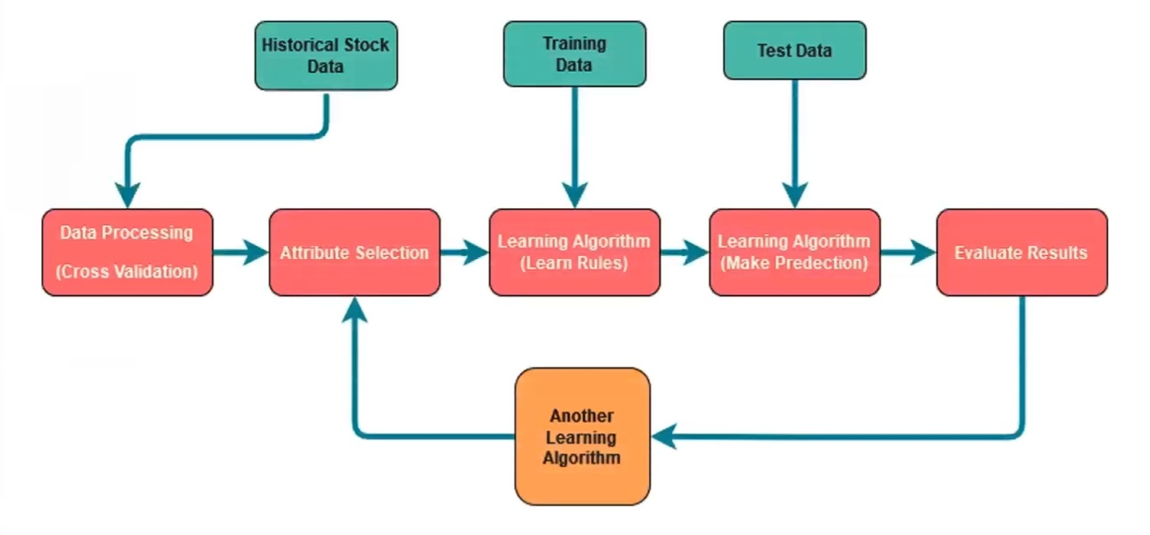
Prediction methodology

Slide 10
Data acquisition
For our project we have collected the historical stock market data of The Coca-Cola Company.
We imported data from Yahoo Finance website which is a premier publisher of alternative data for institutional investors.
We have taken day-wise stock data of the company for five years i.e. from 2018 to 2022.

Slide 11
Data Exploration:
Features of our data:
Opening Price- It’s the price of the first transaction of the day.
Closing Price- It’s the price of the last transaction of the day.
High Price- It’s the price of the highest transaction during that day.
Low Price- It’s the price of the lowest transaction during that day.
Volume- The number of shares or contracts traded in an entire market during a given period of time.

Slide 12
Variables Involved:
1. Target / Dependent variable-
‘Close’, because they are used to create traditional stock charts and other technical indicators by the investors.
2. Independent variable-
‘Open’, ‘High’, ‘Low,’ ‘Volume’.

Slide 13
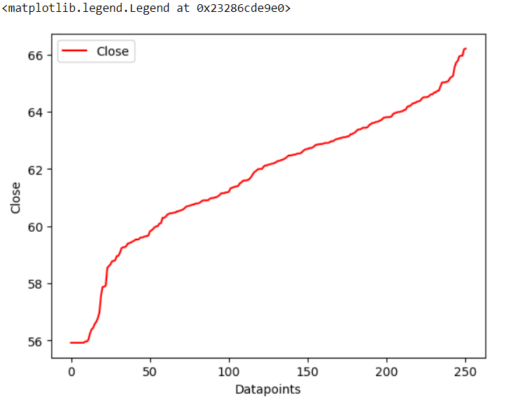

Slide 14
Data pre-processing:
Feature Scaling Of Data:
In this we scale all the independent variables into same range. It is done so that the variables with higher magnitude doesn’t impact the model largely as compared to smaller ones.
Treating Outliers:
Outliers are data points that are distant from rest of observations. They can significantly affect the model and may lead to wrong predictions.
There are different ways of treating outliers:
1. Deletion
2. Imputing
3. Data transformation

Slide 15
Filling Missing values:
The missing values can reduce the performance of the model.
There are two ways of treating missing values:
Deletion and Imputation

Slide 16
Training the model:
Splitting the data into train and test datasets:
We have used the train_test_split method, imported from sklearn.model_selection with test size 0.2(i.e. 80% of data for training and 20% for testing)
Algorithms Used:
Linear Regression
SVR or Support Vector Regression
Random Forest

Slide 17
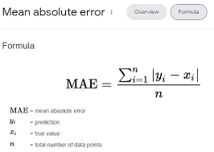


Parameters Used for Comparing the algorithms
Mean Absolute Error = (1/n) * ∑|y_{i} – x_{i}|
where,
Σ: Greek symbol for summation
y_{i}: Actual value for the ith observation
x_{i}: Calculated value for the ith observation
n: Total number of observations
1.Mean Absolute Error(MAE):
Mean absolute error gives the mean of absolute difference between model prediction and target value.

Slide 18
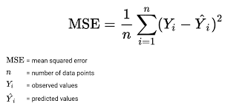
2. Mean Squared Error(MSE):
Mean squared error (MSE) measures the amount of error in statistical models. It assesses the average squared difference between the actual and predicted values.

Slide 19
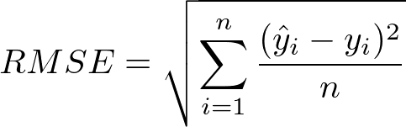
Root Mean Squared Error(RMSE):
Root mean squared error (RMSE) is the square root of the mean of the square of all of the errors.
The use of RMSE is very common, and it is considered an excellent general-purpose error metric for numerical predictions.
RMSE is the square root of mean squared error or MSE.

Slide 20
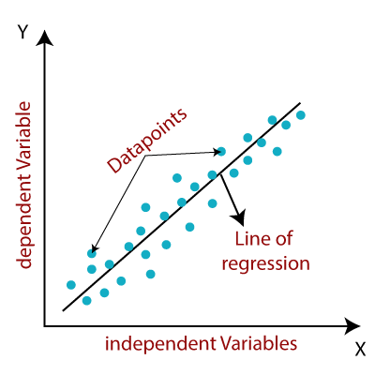
Linear regression
It is a statistical method used for predictive analysis. It makes predictions for continuous/real variables such as sales, product price, stock prices, etc.
It shows a linear relationship between a dependent and one or more independent variables.
We have used LinearRegression() method imported from sklearn library.
y= a0+a1x+ ε
Here,
Y=Dependent Variable (Target Variable)
X= Independent Variable (predictor Variable)
a0= intercept of the line (Gives an additional degree of freedom)
a1 = Linear regression coefficient (scale factor to each input value).
ε = random error

Slide 21
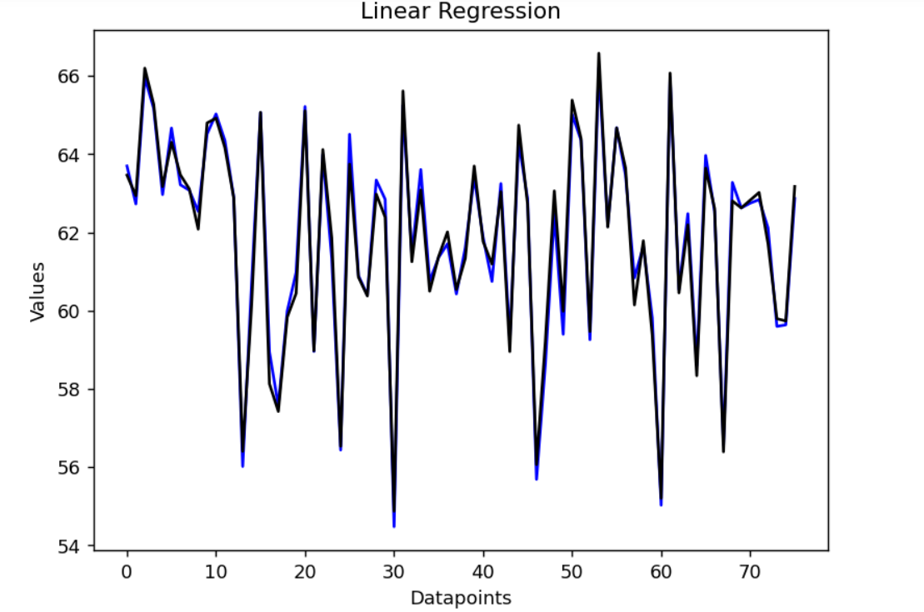
Errors Calculated
Actual Vs. Prediction Graph
Error | Values
MAE | 0.26310764442961015
MSE | 0.10568476202580311
RMSE | 0.32509192857683056

Slide 22
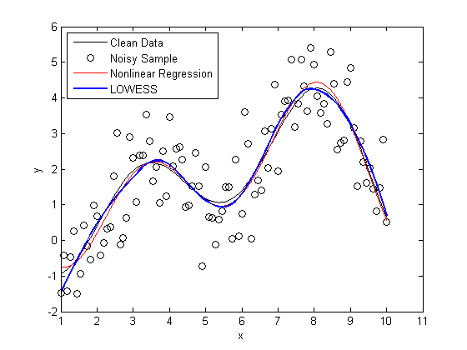
SVR
Support Vector Regression is a supervised learning algorithm that is used to predict discrete values. Support Vector Regression uses the same principle as the SVMs.
The basic idea behind SVR is to find the best-fit line. In SVR, the best-fit line is the hyperplane that has the maximum number of points.
We have used the SVR() method from svm module imported from the sklearn library.
Unlike other Regression models that try to minimize the error between the real and predicted value, the SVR tries to fit the best line within a threshold value. The threshold value is the distance between the hyperplane and boundary line.

Slide 23
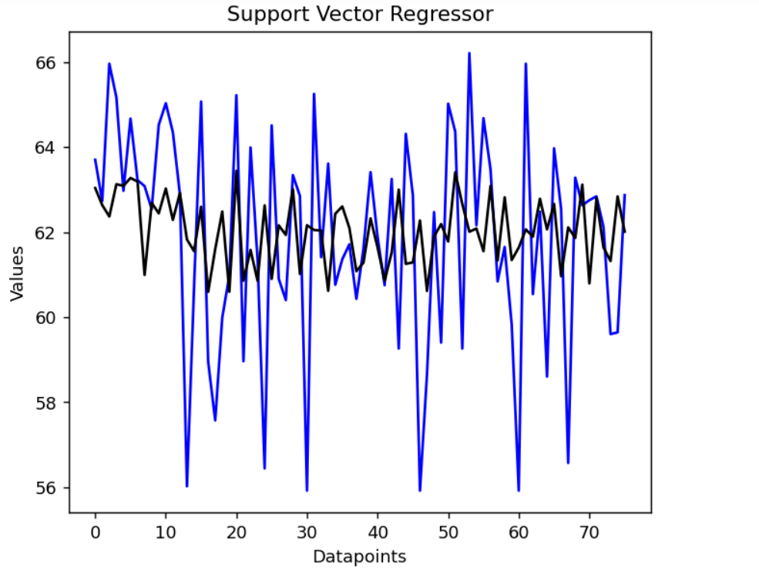
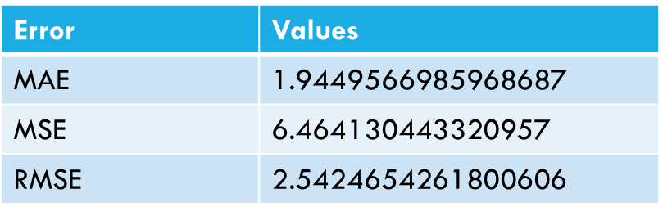
Error Calculated
Actual Vs. Prediction Graph

Slide 24
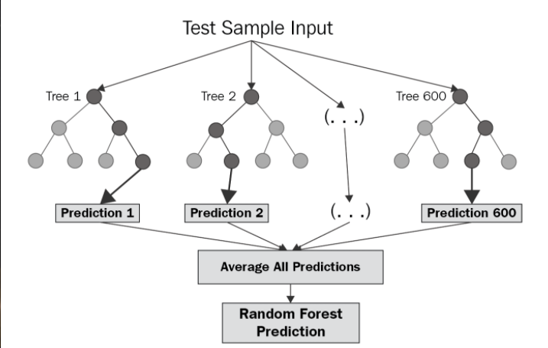

Random forest regressor
Random Forest Regression is a supervised learning algorithm that uses ensemble learning method for regression.
Ensemble learning method is a technique that combines predictions from multiple machine learning algorithms to make a more accurate prediction than a single model.
A Random Forest Regression model is powerful and accurate. It usually performs great on many problems, including features with non-linear relationships.

Slide 25
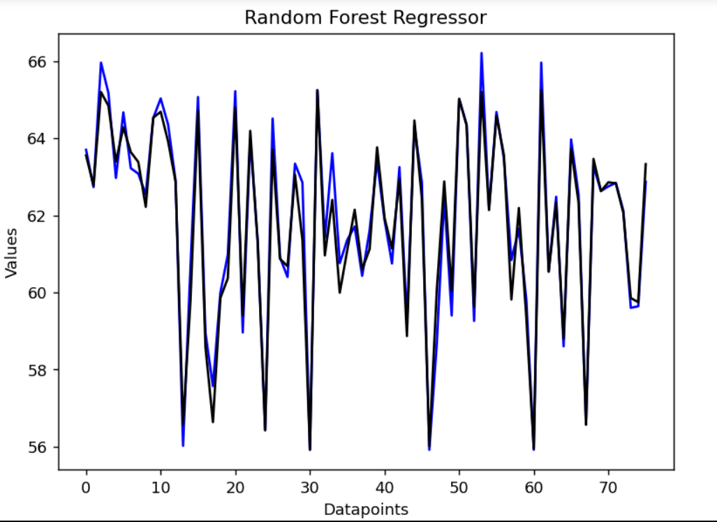
Error Calculated
Actual Vs. Prediction Graph
Error | Value
MAE | 0.35030201559210267
MSE | 0.23129640853240352
RMSE | 0.48093285241539024

Slide 26
CONCLUSION
In this project we studied the use of three supervised learning algorithms namely linear regression, support vector regression and random forest regressor. On comparing all these algos we saw that Linear Regression gave us better results.
The random forest regressor’s error were also comparatively low , therefore it can also be used for prediction.
However each method has its own strengths and weaknesses. In this project, we have used mainly five features of the stock market data. Also a particular ML algorithm might be better suited to a particular type of stock and may give low accuracy for other types of data.

Slide 27



